Slide 1
Introduction to Electrical circuits by Trish Loeblein phet.colorado.edu
Learning Goals: Students will be able to
Discuss basic electricity relationships
Analyze the differences between real circuits and the simulated ones
Build circuits from schematic drawings
Use a multimeter to take readings in circuits.
Provide reasoning to explain the measurements and relationships in circuits.

Slide 2
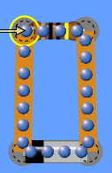
1.If you build this circuit with real equipment, how would you determine the resistance of the resistor?
Use the ohmmeter after connecting the battery.
Use the ohmmeter before connecting the battery.
Measure the current and voltage, then use Ohm’s law
Two of the above.
Notes:
C. You cannot use the ohm meter when there is power to the resistor and measuring the resistance without power will give a value that is less than when powered.

Slide 3
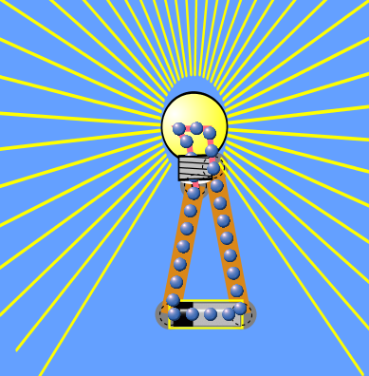
2.If you increase the voltage of the battery, how will the light bulb change?
It will be look brighter because the yellow lines are brighter and longer
It will be less bright because the yellow lines are less bright and shorter
There is no change because the bulb just uses the extra energy without changing brightness
Notes:
A More voltage means more energy so it will be brighter

Slide 4
3.If you increase the voltage of the battery, how will the electron display change?
The blue dots will get bigger to show more energy is being used
The blue dots will move faster to show more energy is being used
There is no change
Notes:
B you could just say V=IR and since no change in resistance current goes up, but you might want to discuss why the electron size isn’t used to indicate more energy.

Slide 5
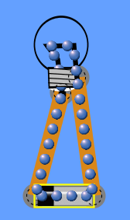
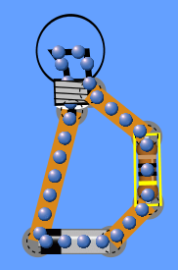
4. If you build circuit A and then add a resistor as in circuit B, the light will
A
B
Look brighter
Look less bright
There will no change in brightness
Notes:
B more resistance means less current to bulb.

